Slide 1

Biodiversity
Group Member
Paritosh Mishra 16UCS124
Parul Shandilya 16UCS126

Slide 2
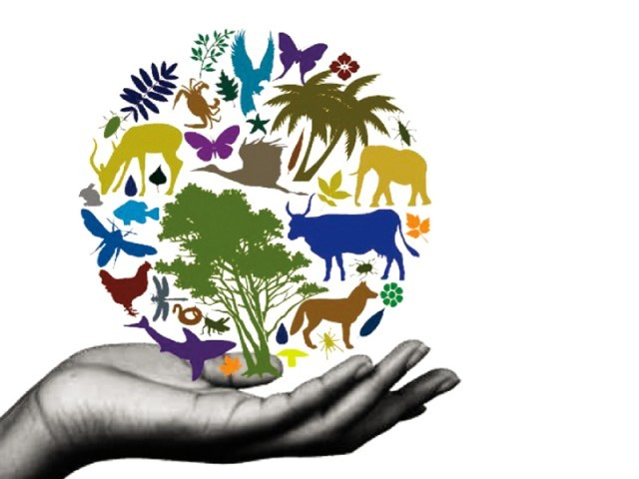
What is Biodiversity?
The variety of plant and animal life in the world or in a particular habitat, a high level of which is usually considered to be important and desirable.
16UCS126

Slide 3
Causes of Man-Animal Conflicts:
i. Habitat shrinking : Causes less space, food etc in the forest result in animals stray out of habitat in search of food, water or shelter. Construction of roads especially big Highways and canals passing through dense jungles and the big mines are some of the reason for habitat shrinking.
ii. Invasion of local people in forest area :Has increased the pressure on the limited natural resources in the forest areas.
iii. Water scarcity : The livestock and wild animals have to share the limited water sources on the fringes or inside forest.
iv. Animal Gazing : The crops like paddy, sugarcane, banana, pulses and vegetables etc are badly damaged mostly by wild boars, deer and blue bulls in this area which raid into the crops frequently leaving the owner farmers crying
and cursing.
16UCS126

Slide 4
Ways to reduce conflicts:
1) Train police and forest department staff.
2) Aware people.
3) Constructing fence/wall to prevent wild animal attack.
4) Movement of animals can also be tracked through GPS.
16UCS126

Slide 5
Conservation measures of biodiversity
Ex-situ conservation:
• Refers to conservation of components of biodiversity outside their
natural habitats, e.g. zoos, museums, gene banks, botanic
gardens/arboretums;
• Used for threatened and endangered species to avoid their
extinction; also known as captive
conservation.
In-situ conservation:
• Refers to conservation of ecosystems and natural habitats
including maintenance and recovery of viable populations of species
in their natural habitats.
National parks and game reserves - These are different from
zoological gardens and are established on terrestrial and aquatic
ecosystems with the objective to preserve wildlife that cannot co-
exist with human beings and human activities. National parks are
under the jurisdiction of central government
while game reserves are managed by the local county council.
16UCS126

Slide 6
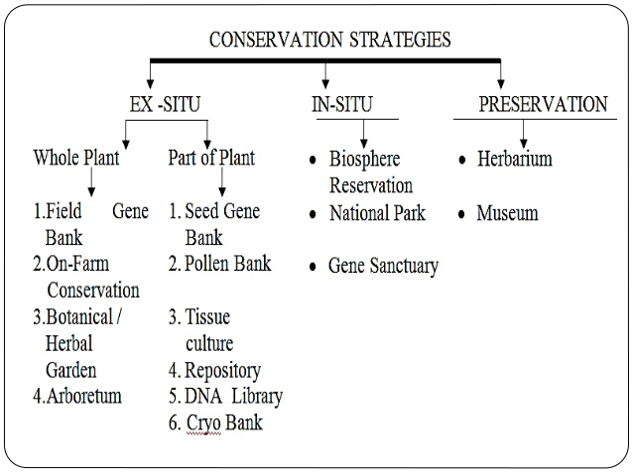
Biodiversity conservation
16UCS126

Slide 7
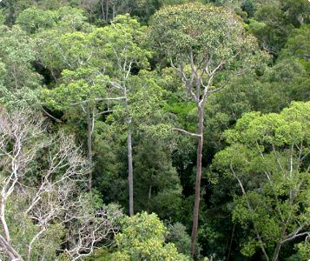
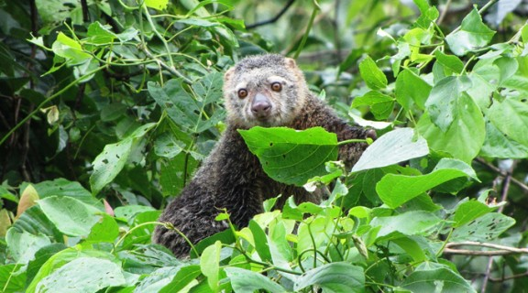
In-situ conservation:
In these areas, hunting, firewood collection, timber harvesting etc.
are prohibited so that the wild plants and animals can grow and
multiply freely without any hindrance.
Some protected areas are:
Cold desert (Ladakh and Spiti),
Hot desert (Thar),
Saline Swampy area (Sunderban and Rann of Kutch),
Tropical moist deciduous forest (Western Ghats and north East) etc.
Protected areas include national parks, sanctuaries and biosphere
reserves. There are 37,000 protected areas throughout the world. As
per World Conservation Monitoring Centre, India has 581 protected
areas, national parks and sanctuaries.
16UCS126

Slide 8
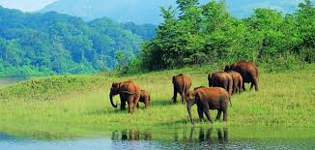
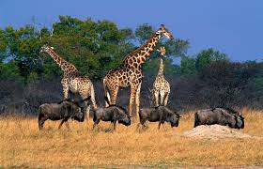
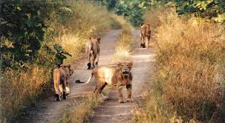
Many National Parks and Sancturies have been established to preserve wildlife in their natural environment. There are about 89
national parks in India. Some of them are:
• Kaziranga sanctuary
• Manas sanctuary
• Kelameru bird sanctuary
• Dachigam sanctuary
• Bandipur sanctuary
• Periyar sanctuary
• Kanha National Park
• Simipal National Park
• Bharatpur bird sanctuary
• Corbett National Park
• Jaladpara sanctuary
16UCS126

Slide 9
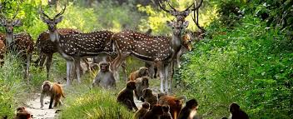
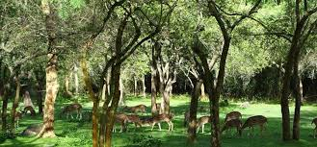
Sanctuaries
These are the areas where only wild animals (fauna) are
present. The activities like harvesting of timbers, collection
of forest products, cultivation of lands etc. are permitted as
long as these do not interfere with the project. That is,
controlled biotic interference is permitted in sanctuaries,
which allows visiting of tourists for recreation. The area
under a sanctuary remains in between 0.61 to 7818 km.
(i) Nandankanan Zoological Park
(ii) Chandaka Elephant reserve
(iii) Simlipal Tiger Reserve
(iv) Bhitarkanika Wild life Sanctuary
(v) Gharial project at Tikarpada
(vi) Chilika (Nalaban) Sanctuary
16UCS126

Slide 10
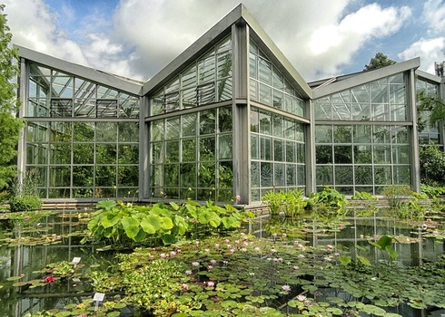
Ex-situ conservation:
Ex-situ conservation involves maintenance and breeding of endangered plants and animals under partially or wholly controlled conditions in specific areas like zoo, gardens, nurseries etc. That is, the conservation of selected plants and animals in selected areas outside their natural habitat
is known as ex-situ conservation.
The stresses on living organisms due to competition for food, water, space etc. can be avoided by ex-situ
conservation there by providing conditions necessary for a secure life and breeding.
Some important areas under these conservation are:
(i) Seed gene bank,
(ii) Field gene bank;
(iii) Botanical gardens ;
16UCS126

Slide 11
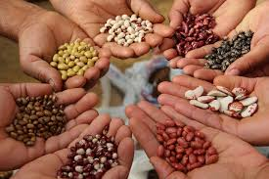
Biodiversity Seed banks in India
Agro-biodiversity can be divided into two
categories:
1) Intraspecific diversity covers the genetic variety within a
single species – such as different sub-species of rice, Basmati
rice, Thai Jasmine rice, Japanese Mochi rice, Sona Masuri, etc.
2) Interspecific diversity refers to the number and types of
different species – such as potatoes, carrots, peppers, lettuce
etc.
16UCS126

Slide 12
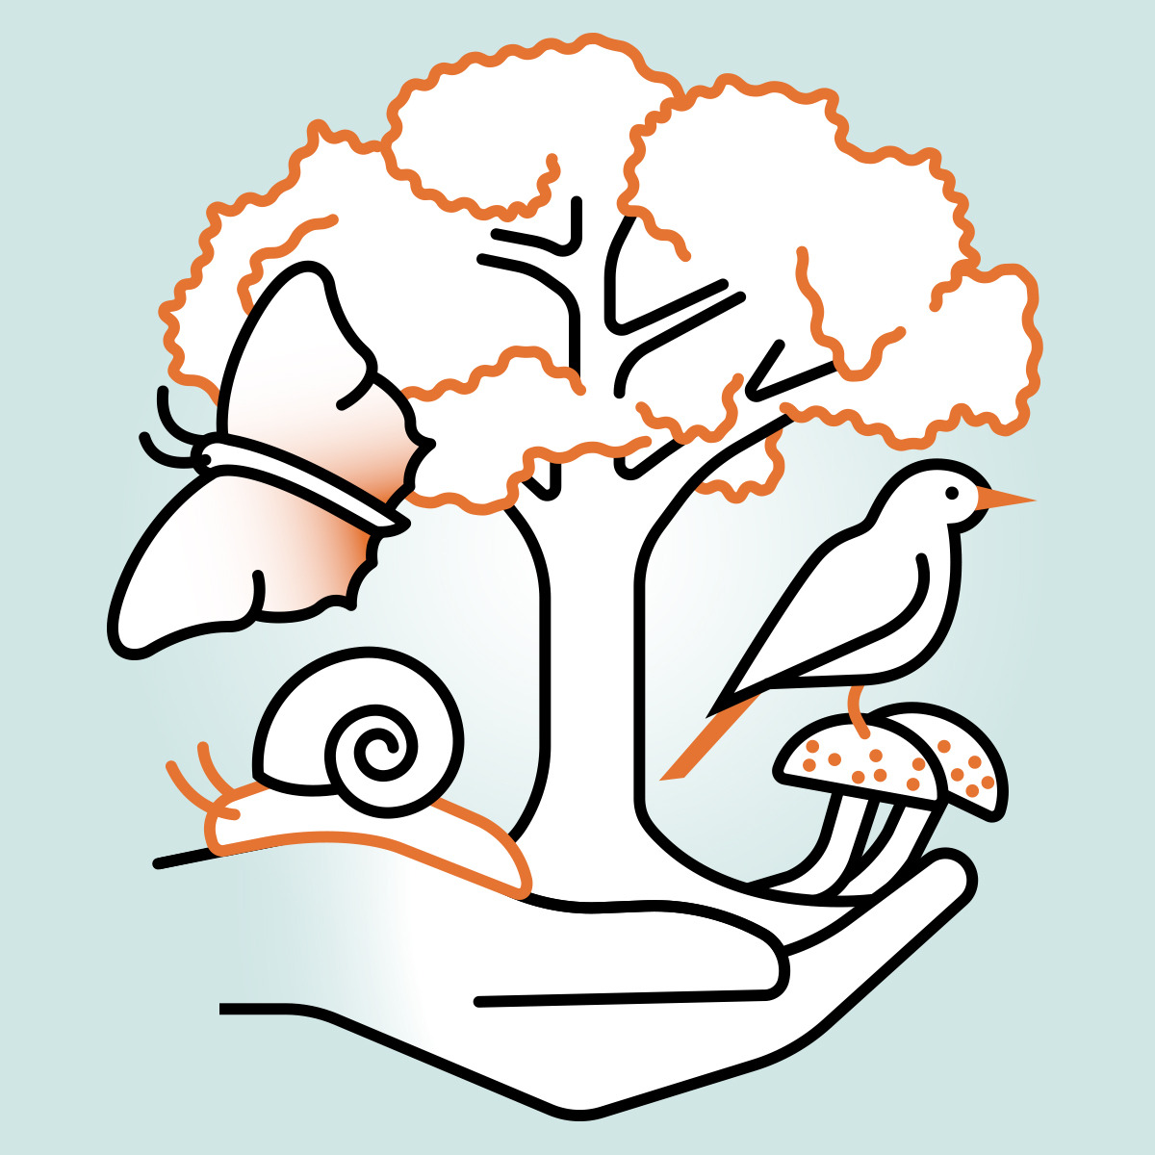
Extinctions: The End of Biodiversity
16UCS124

Slide 13
What is extinction?
Extinctions occur when the last individual of a species dies out.
Functional Extinctions occur when individuals remain but the odds of sustainable reproduction are low
i.e. the species is effectively extinct even though individuals remain.
16UCS124

Slide 14
When do extinctions occur?
Extinctions occur when the environment of a species changes faster than the species can adapt.
In other words, a species’ adaptations are no longer sufficient in allowing that species to acquire and compete for resources.
Extinctions can be local, widespread, or global.
For example, the timber wolf was until recently extinct in Wisconsin but not in Minnesota
Wild elk and woodland caribou are now extinct in Wisconsin but may be found on game farms.
16UCS124

Slide 15
Extinctions are natural.
Extinctions occur naturally.
Nearly all of the species that have existed on earth have gone extinct.
There have been 5 major mass extinctions in geological history.
Recovery from these events took millions of years.
16UCS124

Slide 16
Modern Causes of Extinctions
Major current causes of extinctions include:
Habitat Loss: fragmentation, degradation, and outright destruction of ecosystems that support native ecosystems (leading cause).
Invasive Species: the introduction or overpopulation of species that over-consume natural resources and are uncontrolled by predators (second leading cause).
Over-harvesting: the removal of species at rates that exceed reproduction
Pollution: introduction of harmful agents that reduce the effectiveness of a species’ adaptations
16UCS124

Slide 17
For the birds…
“Of about 6 to 10 million currently existing species, we have still only identified 1 million.”
“For groups that we know well, knowledge of very recent species extinctions…allows us to be certain that extinction rates are comparable to those of the great past extinctions.”
“For birds, of about 10,000 species worldwide
at least 128 have disappeared in the last 500 years
about 1,200 are currently seriously threatened with extinction (all but three from human activities)”
16UCS124

Slide 18
Biodiversity & Medicine
More than a quarter of all prescriptions written annually in the United States contain chemicals discovered in plants and animals.
A few hundred wild species have stocked our pharmacies with antibiotics, anti-cancer agents, pain killers, and blood thinners.
We have only discovered 10-20% of living species so far!
http://www.fws.gov/endangered/esa-library/pdf/Why_Save_Endangered_Species_Brochure.pdf
16UCS124

Slide 19
Biodiversity & Agriculture
There are almost 80,000 species of edible plants
Fewer than 20 produce 90 percent of the world’s food.
4 crops (wheat, corn, rice, soybeans) provide most of the world’s food.
If underutilized species are conserved, they could help to feed growing populations.
http://www.fws.gov/endangered/esa-library/pdf/Why_Save_Endangered_Species_Brochure.pdf
16UCS124

Slide 20
Biodiversity & Crops
During the 1970s the U.S. corn crop was almost completely wiped out by a leaf fungus.
The corn crop was saved by interbreeding it with a rare species of wild corn from Mexico.
Genetic engineering may also offer some hope by facilitating transfer of genes between species.
This increases the value of wild strains which can be used as sources for new traits to be introduced into crops.
http://www.emc.maricopa.edu/faculty/farabee/biobk/biobookcycles.html
16UCS124

Slide 21
Biodiversity & Ecosystem Services
Ecosystem services include air and water purification, detoxification and decomposition of wastes, climate regulation, regeneration of soil fertility, and the production and maintenance of biological diversity.
These are the key ingredients of our agricultural, pharmaceutical, and industrial enterprises.
Such services are estimated to be worth trillions of dollars annually.
We get these services for free…for now.
http://www.fws.gov/endangered/esa-library/pdf/Why_Save_Endangered_Species_Brochure.pdf
16UCS124

